Slide 1
Arithmetic Circuits
Reference:
CMOS VLSI Design A Circuits and Systems Perspective, 4th Edition, by Neil Weste
Handbook of Digital CMOS Technology, Circuits, and Systems by Karim Abbas

Slide 2
Contents
Ripple Carry
Carry Look-Ahead
Carry Skip
Carry Increment
Tree Adder: Brent-Kung, Sklansky, Kogge Stone Adder

Slide 3

Single-Bit Addition
Full Adder
Half Adder
S = A Ꚛ B
C_{out} = AB + BC + AC
C_{out} = A . B
A | B | C | C_{out} | S
0 | 0 | 0 | 0 | 0
0 | 0 | 1 | 0 | 1
0 | 1 | 0 | 0 | 1
0 | 1 | 1 | 1 | 0
1 | 0 | 0 | 0 | 1
1 | 0 | 1 | 1 | 0
1 | 1 | 0 | 1 | 0
1 | 1 | 1 | 1 | 1
A | B | C_{out} | S
0 | 0 | 0 | 0
0 | 1 | 0 | 1
1 | 0 | 0 | 1
1 | 1 | 1 | 0

Slide 4
Carry-Ripple Adder
Example: Consider adding two 4-bit binary numbers, A = 1011 and B = 1101
A = 1011
B = 1101
The result is 11000, with a final carry-out (C₄) of 1
S = 11000

Slide 5
Advantages:
Simplicity: The design is straightforward, making it easy to understand and implement
Scalability: It's simple to extend the adder to handle more bits by adding more full adders
Disadvantages:
Speed: The main drawback of a Ripple Carry Adder is its speed. The carry output from each full adder must propagate to the next adder, causing a delay proportional to the number of bits (n). This delay is known as the carry propagation delay
Performance: For large bit-widths, this delay can be significant, making ripple carry adders slower than other adders like the Carry Look-ahead Adder (CLA) or the Carry Save Adder (CSA)

Slide 6
Applications:
Ripple Carry Adders are used in situations where simplicity and ease of implementation are more important than speed, such as in small-scale arithmetic operations in digital circuits or as part of more complex adders in hierarchical designs.

Slide 7
Carry Look-Ahead Adder
Most other arithmetic operations, e.g. multiplication and division are implemented using several add/subtract steps. Thus, improving the speed of addition will improve the speed of all other arithmetic operations
One widely used approach employs the principle of carry look-ahead solves this problem by calculating the carry signals in advance, based on the input signals. This type of adder circuit is called as Carry Look-Ahead adder (CLA adder)
Unlike the Ripple Carry Adder, where each carry bit must wait for the previous one to be computed, the CLA adder calculates carry bits in advance based on the input bits, thereby "looking ahead" to the final result

Slide 8
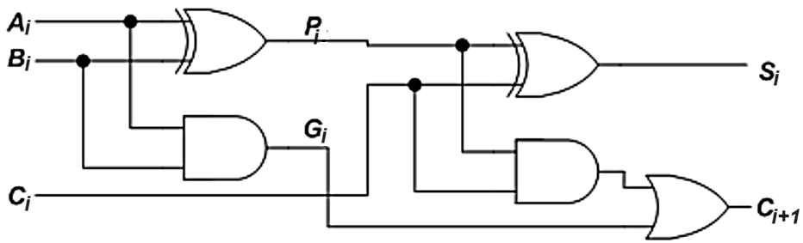
It is based on the fact that a carry signal will be generated in two cases:
when both bits A_{i} and B_{i} are 1, or
when one of the two bits is 1 and the carry-in (carry of the previous stage) is 1.
That is,
C_{i+1} = A_{i}.B_{i} + (A_{i}⊕B_{i}) C_{i}
A_{i}.B_{i} is called Carry generate, G_{i}
A_{i}⊕B_{i} is called Carry propagate, P_{i}
Therefore,
C_{i+1} = G_{i} + P_{i}C_{i}
S_{i} = P_{i} ⊕ C_{i}
Alternatively, many adders use K’_{i} = A_{i} + B_{i} in place of P_{i} because OR is faster than XOR.
S_{i} = P_{i} ⊕ G_{i-1:0}

Slide 9
The Boolean expression of the carry outputs of various stages can be written as follows:
C₁ = G₀ + P₀C₀
C₂ = G₁ + P₁C₁ = G₁ + P₁ (G₀ + P₀C₀)
= G₁ + P₁G₀ + P₁P₀C₀
C₃ = G₂ + P₂C₂ = G₂ + P₂ (G₁ + P₁G₀ + P₁P₀C₀)
= G₂ + P₂G₁ + P₂P₁G₀ + P₂P₁P₀C₀
C₄ = G₃ + P₃C₃
= G₃ + P₃G₂ + P₃P₂G₁ + P₃P₂P₁G₀ + P₃P₂P₁P₀C₀

Slide 10
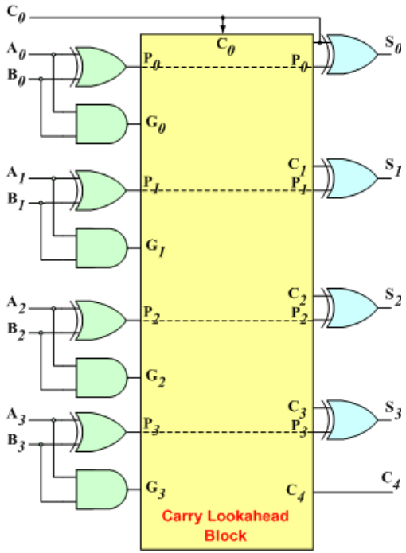
The 2-level implementation of the carry signals has a propagation delay of 2 gates, 2τ
The 4-bit carry look-ahead (CLA) adder consists of 3 levels of logic:
First level: Generates all the P & G signals. Four sets of P & G logic (each consists of an XOR gate and an AND gate). Output signals of this level (P’s & G’s) will be valid after 1τ
Second level: The CLA logic block which consists of four 2-level implementation logic circuits. It generates the carry signals (C₁, C₂, C₃, and C₄). Output signals of this level (C₁, C₂, C₃, and C₄) will be valid after 3τ
Third level: Four XOR gates which generate the sum signals (S_{i}) (S_{i} = P_{i} ⊕ C_{i}). Output signals of this level (S₀, S₁, S₂, and S₃) will be valid after 4τ

Slide 11
Thus, the 4 Sum signals (S₀, S₁, S₂ & S₃) will all be valid after a total delay of 4τ compared to a delay of (2n+1)τ for Ripple Carry adders.
For a 4-bit adder (n = 4), the Ripple Carry adder delay is 9τ.
The disadvantage of the CLA adders is that the carry expressions (and hence logic) become quite complex for more than 4 bits.
Thus, CLA adders are usually implemented as 4-bit modules that are used to build larger size adders.

Slide 12

16 Bit – Carry lookahead adder
Group Generate and Propagate
For larger adders, it is inefficient to compute each carry bit individually, especially as the number of bits grows. Instead, the CLA uses group generate and group propagate to compute carries for groups of bits in parallel.
Group Generate (G₀₋₃) for a group of bits from bit 0 to bit 3: This signal indicates that a carry is generated somewhere within the group and will produce a carry-out from the group, regardless of the carry input to the group. It can be thought of as an "or" condition across multiple generate conditions within the group.
Group Propagate (P₀₋₃) for the same group: This signal indicates that if there is a carry-in to the group, it will be propagated through to the next group. It is an "and" condition across all propagate conditions within the group.

Slide 13
Calculating Group Generate and Group Propagate
For a group of 4 bits (let’s say bits 0 to 3), the group generate and propagate can be defined as:
Group Generate (G₀₋₃):
G₀₋₃ = G₃+(P₃⋅G₂) + (P₃⋅P₂⋅G₁) + (P₃⋅P₂⋅P₁⋅G₀)
This means that the group will generate a carry if the most significant bit generates a carry (G₃), or if the carry is propagated through any combination of bits up to the most significant bit that generates a carry.
Group Propagate (P₀₋₃):
P₀₋₃=P₃⋅P₂⋅P₁⋅P₀​
This means that the group will propagate a carry if all bits within the group propagate the carry.

Slide 14
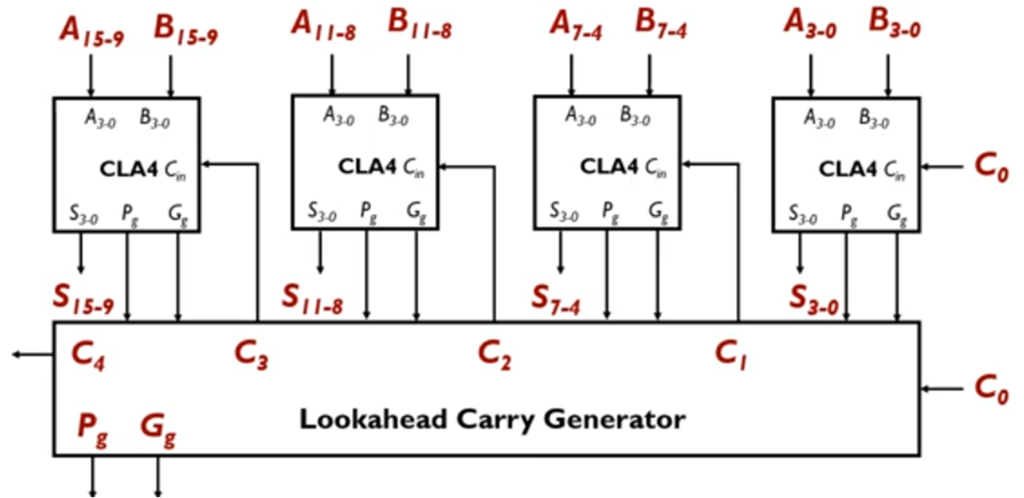
Use Group Generate and Propagate to Calculate Carry-Out for Group:
If you have a carry-in C₀​ for the 4-bit group, the carry-out C₄​ can be calculated using the group generate and propagate:
C₄ = G₀₋₃ + (P₀₋₃⋅C₀)

Slide 15
Applications
Carry Look-Ahead Adders are used in situations where high-speed arithmetic operations are critical, such as in:
ALUs (Arithmetic Logic Units): High-performance processors and microcontrollers.
Floating-point units: In CPUs and GPUs for faster addition operations.
Digital Signal Processing (DSP): For efficient computations in signal processing tasks.
Overall, the CLA adder offers a significant speed advantage over simpler adder designs, making it a popular choice for high-speed computing applications.

Slide 16

PGK
For a full adder, define what happens to carries
Generate: C_{out} = 1 independent of C
G = A • B
Propagate: C_{out} = C
P = A ⊕ B
Kill: C_{out} = 0 independent of C
K = ~A • ~B

Slide 17
Carry Propagate Adders
Carry into each bit can influence the carry into all subsequent bits.
N-bit adder
Each sum bit depends on all previous carries
How do we compute all these carries quickly?

Slide 18
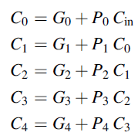

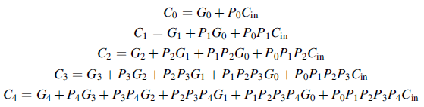
Group Generate / Propagate

Slide 19

Group Generate / Propagate

Slide 20
Group Generate / Propagate
Equations often factored into G and P
Generate and propagate for groups spanning i:j
Base case
Sum:
Notes:
In other words, a group generates a carry if the upper (more significant) or the lower portion generates and the upper portion propagates that carry.
The group propagates a carry if both the upper and lower portions propagate the carry

Slide 21
PG Diagram Notation
Notes:
Generation of the carry would require an AND + an OR gate
G_{i:0} =G_{i} + P_{i} ·G_{i-1:0} => C₁ = Carry Generation Equation itself

Slide 22

PG Logic

Slide 23
Carry-Ripple Revisited

Slide 24
Carry-Ripple PG Diagram
Notes:
Each line represents a bundle of the group generate and propagate signals (propagate signals are omitted after gray cells).

Slide 25
Carry-Skip/ Carry-Bypass Adder
Carry-ripple is slow through all N stages
Carry-skip allows carry to skip over groups of n bits
Decision based on n-bit propagate signal
Notes:
Rectangles – bitwise propagate and generate logic and 4 input AND gate to compute p0.p1.p2.p3
If p0.p1.p2.p3 is FALSE then ripple carry is propagated to the next level

Slide 26
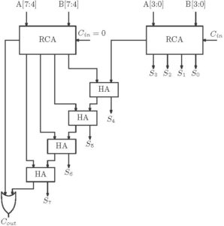
Carry-Increment Adder
Consists of RCA’/CLAs and incremental circuitry

Slide 27

Carry-Increment Adder
An 8-bit increment adder includes two RCA of four bit each.
The first ripple carry adder adds a desired number of first 4-bit inputs generating a plurality of partitioned sum and partitioned carry.
Now the carry out of the first block RCA is given to C_{IN} of the conditional increment block.
Thus the first four bit sum is directly taken from the ripple carry output.
The second RCA block regardless of the first RCA output will carry out the addition operation and will give out results which are fed to the conditional increment block.
The input C_{IN} to the first RCA block is given always low value.
The conditional increment block consists of half adders.
Based on the value of C_{out} of the 1st RCA block, the increment operation will take place.
Here the half adder in carry increment block performs the increment operation.
Hence the output sum of the second RCA is taken through the carry increment block.
Notes:
Reference: Area, Delay and Power Comparison of Adder Topologies

Slide 28
Tree Adder
If lookahead is good, lookahead across lookahead!
Recursive lookahead gives O(log N) delay
Many variations on tree adders

Slide 29
Brent-Kung Adders
Logic Stages For Logarithmic/Tree Adders
Black circular unit - dot operator – compute group propagate and generate logic
Parallel adder made in a regular layout with an aim of minimizing the chip area and ease of manufacturing.
The addition of n-bit number can be performed in time O(log₂(n)) with a chip size of area O(n*log₂(n))

Slide 30

Kogge-Stone (KS) Adders
Depth of the KS adder increases logarithmically with the number of bits.
The depth is defined as the number of units in series from the earliest input to the last output, thus it is also the critical path.
Thus, the KS adder is O(log₂n) in complexity.
While its delay at very low bit lengths can be worse than simpler adders, its scaling behavior is unchallenged and thus it is among the fastest large adders.
This behavior is common among most PPAs.
Disadvantage is, its area. The 4-bit KS adder has 5 dot operators acting in parallel. The 8-bit adder has 17 adders, while the 16-bit adder contains 49 adders.
Notes:
Sklansky adder – suffers from fan-out problems

